Slide 1
Lab 7 Proxy Lab

Slide 2
Contents
Introduction
Overview of proxy server
Instructions
Specification
Functions in csapp.c
Detail
Checking and Grading

Slide 3
Introduction: Proxy Server
A middleman between a web browser (client) and an end server (HTTP server)
Useful for many purposes (firewall, authentication, etc)
Can be used for caching web contents: the end server does not have to send the same file again
User
Proxy
End server
GET index.html
GET index.html
Send index.html
Send index.html

Slide 4
Introduction: Proxy Server
A middleman between a web browser (client) and an end server (HTTP server)
Useful for many purposes (firewall, authentication, etc)
Can be used for caching web contents: the end server does not have to send the same file again
User
Proxy
End server
GET index.html
Send index.html
Cached index.html

Slide 5
Introduction: Proxy Server
Behavior of proxy server
Listen user’s request
Check whether HTTP header is valid or not
Forward it to HTTP server (in this lab, to tiny web server)
Receive the response from HTTP server
Forward it to the user
User
Proxy
End server
① GET index.html
② check valid
③ GET index.html
⑤ Send index.html
④ Send index.html

Slide 6
Specification
Your goal: write a simple HTTP proxy that
Basic sequential web proxy (Section 3)
Deal with multiple concurrent requests (Section 4)
Cache web objects (Section 5)
Write proxy.c which is in the top directory
Implement step by step: first implement basic sequential web proxy, and then add concurrent functionality
Use functions in csapp.c/csapp.h

Slide 7
Functions in csapp.c
Client/server helpers
open_listenfd(): Listen user’s request, the function returns a listening socket’s file descriptor
open_clientfd(): Open connection to server and return a socket descriptor ready for reading and writing
Robust IO package
rio_readlineb(): read a text line buffered
rio_writen(): write n-byte text
…
Pthread package: required to handle concurrent request
Pthread_create(): create a new thread
… and so on

Slide 8
Specification: Detail
Basic sequential web proxy (Section 3)
Listen user’s request, handle it, and listen next request
Use client/server helper functions
Handling the request
Read HTTP header via RIO package and check it valid
Forward it to tiny web server
Listen to response of the tiny web server
Forward it to the user
Deal with multiple concurrent requests (Section 4)
Same with 1., but handling the request is done in separate threads
After creating thread, the main thread waits the next request → can handle several requests at the same time
Use Pthread package

Slide 9
Specifications: Detail
Cache web objects (Section 5)
Save the data sent from the tiny web server into memory
When another user requests the same data, send it instead of requesting it to the tiny web server
Save the data via dynamic storage allocation wrappers
Malloc(), Realloc(), Calloc()
Your proxy’s total cache size should be 1MB
Defined in proxy.c (#define MAX_CACHE_SIZE 1049000)
Refer to section 5.1 in document
Your proxy should only cache web objects that size < 100KB
Defined in proxy.c (#define MAX_OBJECT_SIZE 102400)
Refer to section 5.2 in document
Cache replacement policy: LRU (don’t have to be exactly same, but should be reasonably close)

Slide 10
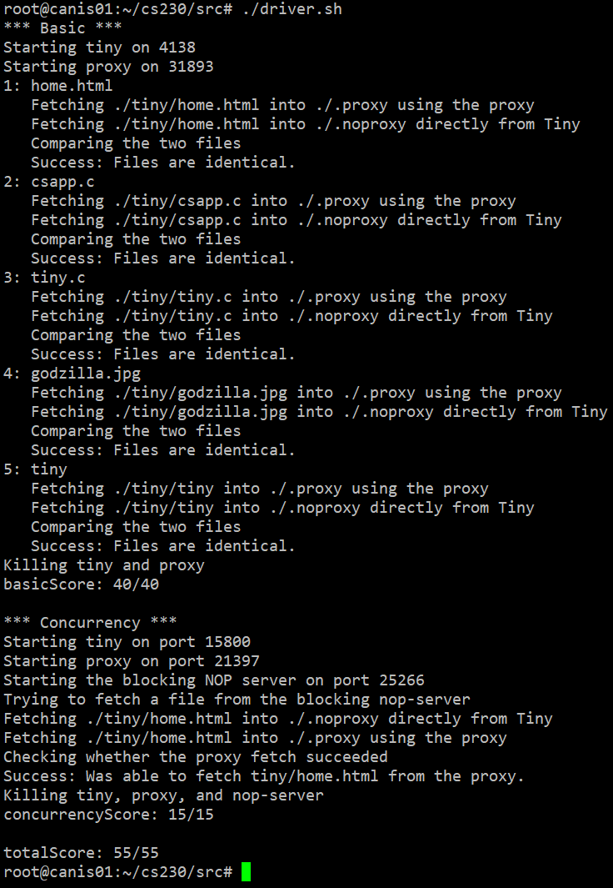
Checking and Grading
Use autograder
Linux> ./driver.sh
Automatically run tiny web server and your proxy
main() in proxy.c runs when your proxy program runs.
Check basic, concurrency, and cache functionality step by step
Grading
TA will use the same autograder.
Cache will not be included.
No style score.

